Slide 1
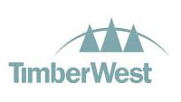
Preparing for Growth With Microsoft Dynamics® AX
Seeing an opportunity for corporate growth, TimberWest Forest Corporation wanted to replace its aging financial management system for a more solid platform.
Microsoft Dynamics was selected as the best system for its capacity in growth, time to value, and ability to handle multiple corporate entities and multiple currencies, as well as enabling the automation of business processes as the business grows.
Prepares the company for rapid scaling
Attracts investment through reduced risk
Increases efficiency of a collaborative ERP
Rapid time-to-value, avoiding the larger overhead of other ERPs
“TimberWest chose NTT DATA because [of] their proven track record in managing Microsoft Dynamics AX projects. NTT DATA brought together a dedicated and knowledgeable team that we felt provided us with the best opportunity to complete the project successfully.”
— Al Shirley, IT Manager, TimberWest
READ THE CASE STUDY >>

