Slide 1
Roadmap to Windows 365 Digital Workplace Services
April 2023

Slide 2
Flexibility is The New Normal
73%
of workers say they want flexible remote work options
67%
of employees want more in-person collaboration
80%
of managers expect more flexible work from home policies
Sources:
1. “The Work Trend Index” survey was conducted by an independent research firm, Edelman Data x Intelligence, among 31,092 full-time employed or self-employed workers across 31 markets between January 12, 2021 to January 25, 2021.
Notes:
Sustainability
OEMs use recyclable packaging where possible
Disposal/Recycling – For those assets that have reached end-of-life and are not part of a lease program that requires return to the lessor, NTT DATA can provide recycling services that includes preparation, packing materials, and shipping, where applicable, in a manner that follows EPA or equivalent local/country specific agency guidelines.
‘Green’ disposal alternatives are available for clients who elect to buy devices. Options we can provide via our partners include remarketing (net proceeds may be shared with client per pre-agreed business rules) or recycling of parts. Note that leased devices disposal will be handed by OEM at end of lease.

Slide 3
Hybrid work Creates New Opportunities, And New Challenges
Onboarding and provisioning
Business continuity
Security and regulation
Zero-touch approach to getting employees, vendors, and contractors up and running across a variety of devices and locations.
Responding quickly to changing workplace situations to mitigate negative impact and seize opportunities.
Securing organizational and customer data while addressing growing complexity in compliance, without sacrificing productivity.
Notes:
Sustainability
OEMs use recyclable packaging where possible
Disposal/Recycling – For those assets that have reached end-of-life and are not part of a lease program that requires return to the lessor, NTT DATA can provide recycling services that includes preparation, packing materials, and shipping, where applicable, in a manner that follows EPA or equivalent local/country specific agency guidelines.
‘Green’ disposal alternatives are available for clients who elect to buy devices. Options we can provide via our partners include remarketing (net proceeds may be shared with client per pre-agreed business rules) or recycling of parts. Note that leased devices disposal will be handed by OEM at end of lease.

Slide 4
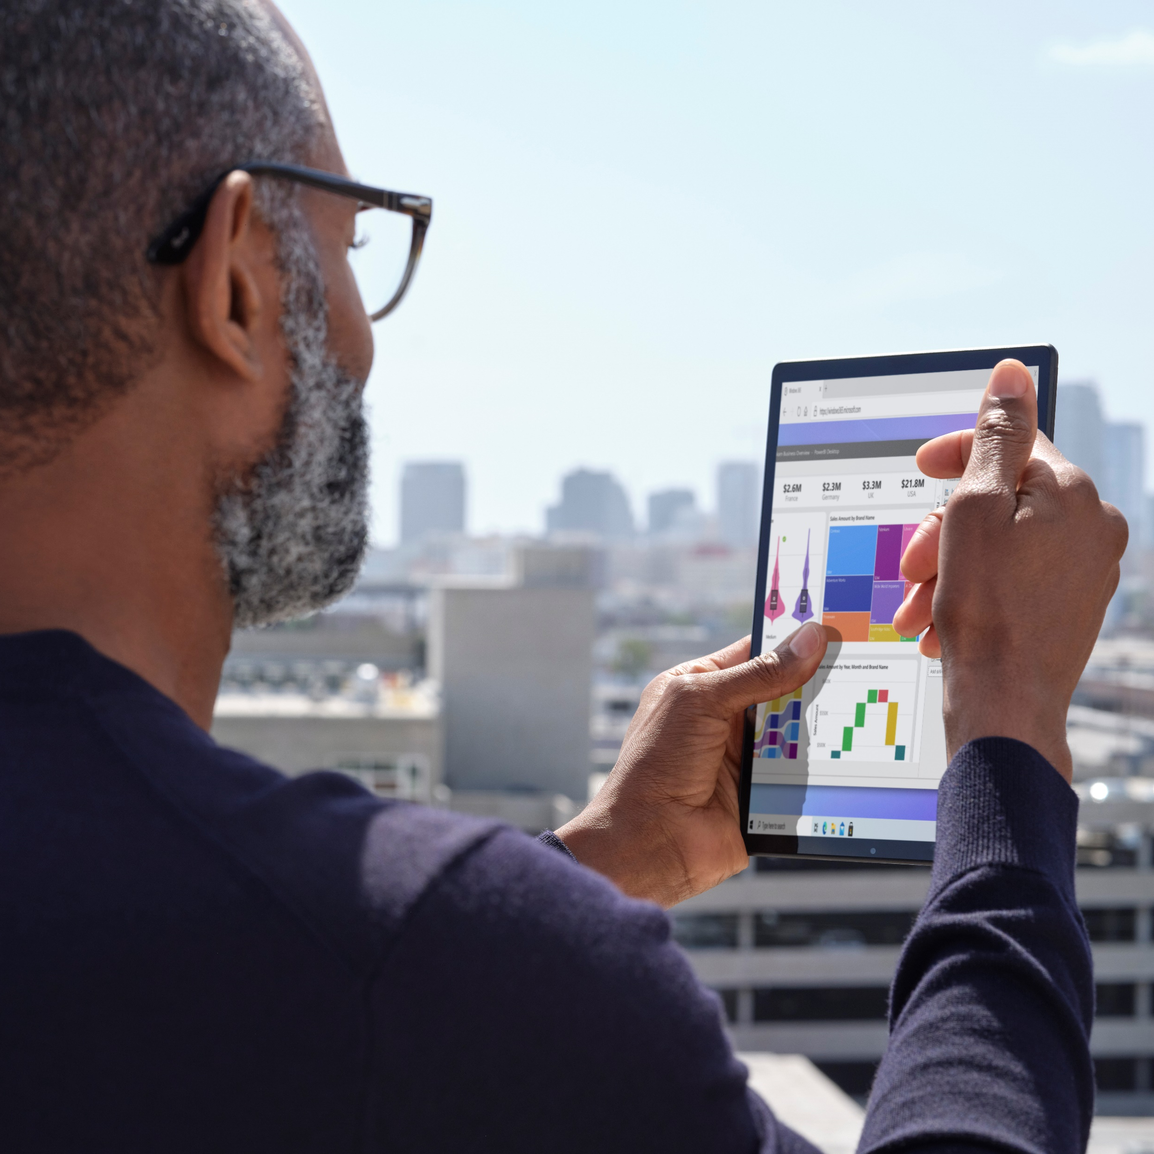
Welcome to your Windows 365 Cloud PC
A new solution for today’s hybrid workforce
Your content wherever you go
Compute options for different users
Consistent settings across devices
The apps you need, when you need them
Scalable storage based on your needs
Integrated unified security and identity management
Notes:
Sustainability
OEMs use recyclable packaging where possible
Disposal/Recycling – For those assets that have reached end-of-life and are not part of a lease program that requires return to the lessor, NTT DATA can provide recycling services that includes preparation, packing materials, and shipping, where applicable, in a manner that follows EPA or equivalent local/country specific agency guidelines.
‘Green’ disposal alternatives are available for clients who elect to buy devices. Options we can provide via our partners include remarketing (net proceeds may be shared with client per pre-agreed business rules) or recycling of parts. Note that leased devices disposal will be handed by OEM at end of lease.

Slide 5
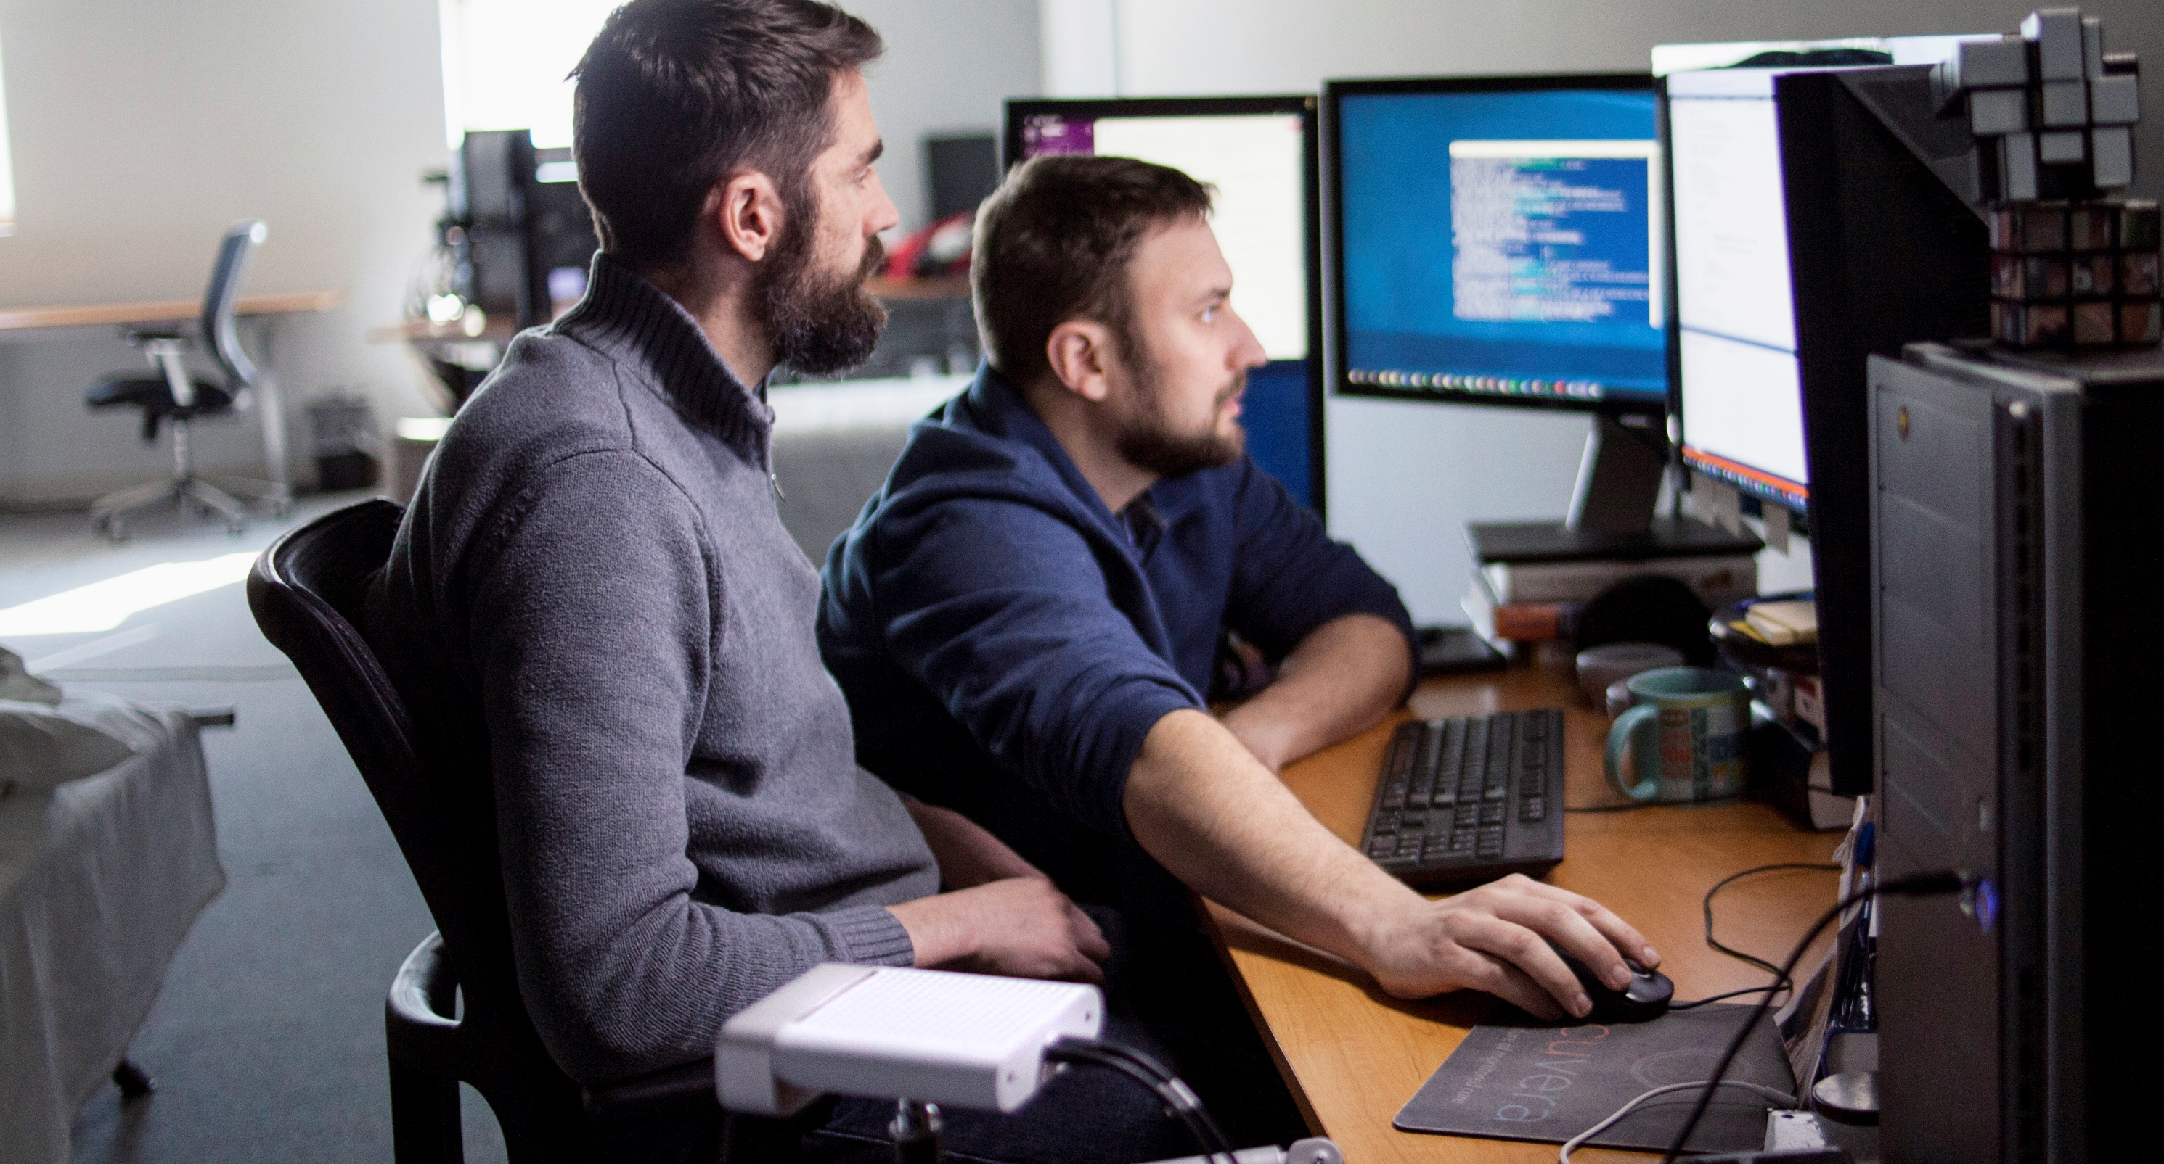
Meet Employees and IT Expectations
Liked by Employees
Trusted by IT
Streamed to any devices
Always ready and updated
Personal and familiar
Scalable ​ and resilient
Predictable costs
Easy to buy, deploy, and manage

Slide 6
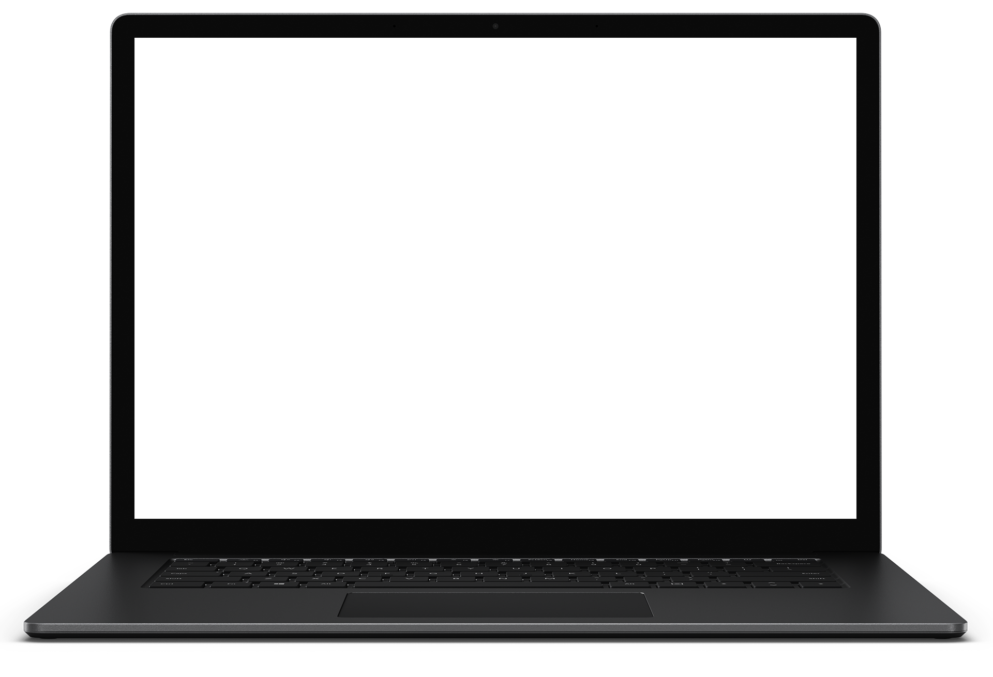
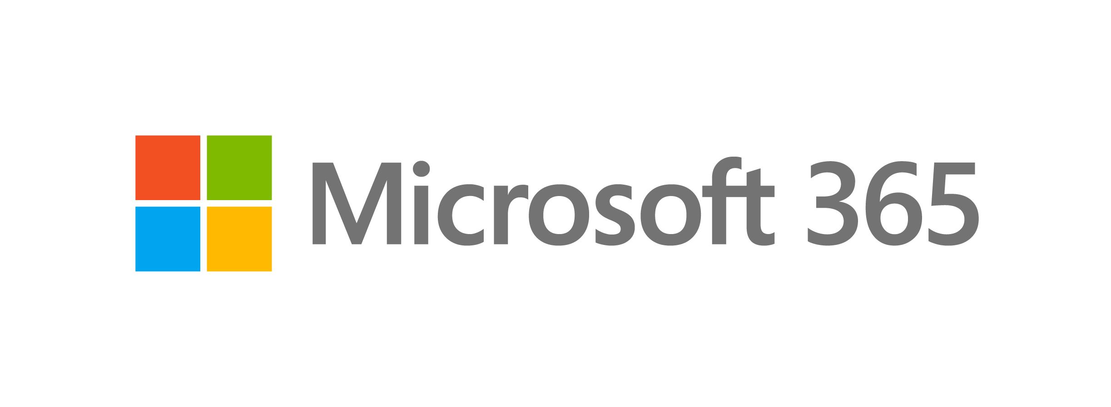
Out-of-the-box Integration in Microsoft 365 Ecosystem
Azure Active Directory Identity
Benefits of Windows 365:
Procure, provision and deploy in minutes
Enable anywhere access for user on their choice of device
Tailor compute and configuration for an elastic workforce
Pick up where you left off on the device of your choice
Predictable cost model
Secure by design
Better compliance
Microsoft 365 Apps
Microsoft Defender
Microsoft Endpoint Manager
Notes:
Sustainability
OEMs use recyclable packaging where possible
Disposal/Recycling – For those assets that have reached end-of-life and are not part of a lease program that requires return to the lessor, NTT DATA can provide recycling services that includes preparation, packing materials, and shipping, where applicable, in a manner that follows EPA or equivalent local/country specific agency guidelines.
‘Green’ disposal alternatives are available for clients who elect to buy devices. Options we can provide via our partners include remarketing (net proceeds may be shared with client per pre-agreed business rules) or recycling of parts. Note that leased devices disposal will be handed by OEM at end of lease.

Slide 7
Windows 365 SKUs and Sample Use Cases
VM/OS Disk Size | Example Scenarios | Recommended Apps
1 vCPU/2 GB/64 GB | Firstline Workers, Call centers, Education/Training/CRM access | Office light (web-based), Microsoft Edge, OneDrive, lightweight line-of-business app (e.g., call center application—web-apps), Defender support
2 vCPU/4 GB/256 GB 2 vCPU/4 GB/128 GB 2 vCPU/4 GB/64 GB | Mergers and acquisitions, Short-term and seasonal, Customer Services, Bring-Your-Own-PC, Work from home | Microsoft 365 Apps, Microsoft Teams (audio-only), Outlook, Excel, PowerPoint, OneDrive, Adobe Reader, Edge, Line-of-business app(s), Defender support
2 vCPU/8 GB/256 GB 2 vCPU/8 GB /128 GB | Bring-Your-Own-PC, Work from home, Market researchers, Government, Consultants | Microsoft 365 Apps, Microsoft Teams, Outlook, Excel, Access, PowerPoint, OneDrive, Adobe Reader, Edge, Line-of-business app(s), Defender support
4 vCPU/16 GB/512 GB 4 vCPU /16 GB /256 GB 4 vCPU /16 GB /128 GB | Finance, Government, Consultants, Healthcare services, Bring-Your-Own-PC, Work from home | Microsoft 365 Apps, Microsoft Teams, Outlook, Excel, Access, PowerPoint, Power BI, Dynamics 365, OneDrive, Adobe Reader, Edge, Line-of-business app(s), Defender support
8 vCPU /32 GB /512 GB 8 vCPU /32 GB /256 GB 8 vCPU /32 GB /128 GB | Software developers, Engineers, Content creators, Design and engineering workstations | Microsoft 365 Apps, Microsoft Teams, Outlook, Access, OneDrive, Adobe Reader, Edge, Power BI, Visual Studio Code, Line-of-business app(s), Defender support
Notes:
Sustainability
OEMs use recyclable packaging where possible
Disposal/Recycling – For those assets that have reached end-of-life and are not part of a lease program that requires return to the lessor, NTT DATA can provide recycling services that includes preparation, packing materials, and shipping, where applicable, in a manner that follows EPA or equivalent local/country specific agency guidelines.
‘Green’ disposal alternatives are available for clients who elect to buy devices. Options we can provide via our partners include remarketing (net proceeds may be shared with client per pre-agreed business rules) or recycling of parts. Note that leased devices disposal will be handed by OEM at end of lease.

Slide 8
Technical and License Requirements
License
Windows license(E3+), Intune license or EMS, AAD P1+, Windows 365 licenses
Azure Subscription
At least 1 needed for an Azure Virtual Network if required
Network
Azure Virtual Network with line of sight to Domain Controller (only for HAADJ)
Machine Identity
Hybrid Azure AD Join (HAADJ)
orc
Azure AD Join (AADJ)
User Identity
Hybrid users (AD + AAD)
Or
AAD users
Image
Gallery or BYO in Azure
(Win10 Ent 21H+ & Windows 11 Ent
Management
Microsoft Endpoint Manager
(supports MECM co-management)
Admin Permissions
M365: Intune Service Admin (standard MEM RBAC after provisioning)
Azure: Subscription Owner (setup network connection if required)
1. Intune + AADP1 can be used as substitute for EMS E3
Notes:
Sustainability
OEMs use recyclable packaging where possible
Disposal/Recycling – For those assets that have reached end-of-life and are not part of a lease program that requires return to the lessor, NTT DATA can provide recycling services that includes preparation, packing materials, and shipping, where applicable, in a manner that follows EPA or equivalent local/country specific agency guidelines.
‘Green’ disposal alternatives are available for clients who elect to buy devices. Options we can provide via our partners include remarketing (net proceeds may be shared with client per pre-agreed business rules) or recycling of parts. Note that leased devices disposal will be handed by OEM at end of lease.

Slide 9
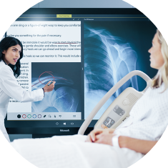
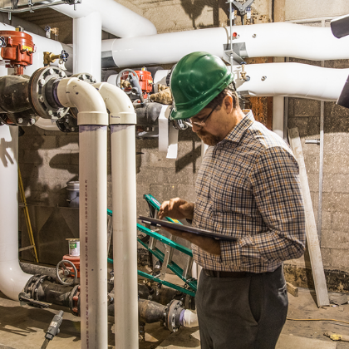
When is Virtualization Useful?
Security
and regulation
Elastic
workforce
Remote
employees
Specialized
workloads
Financial services
Healthcare
Government
Mergers and acquisition
Short-term employees
Contractors and partners
BYOD and mobile
Call centers
Branch workers
Design and engineering
Legacy apps
Software dev test

Slide 10
Selecting the right solution(s)
Windows 365
Personalized Windows 365 Cloud PCs available across devices
Simple and turn-key to buy and deploy
Predictable per user, per month pricing
Easily scalable compute and storage
No VDI experience or skills required
Azure Virtual Desktop
Flexibility and control
Multi-session Windows VMs
Data residency and geo requirements
Remote app streaming
Specialized GPU and HPC workloads
Scalable compute and storage to optimize for cost and experience
Azure Virtual Desktop with Citrix and VMware VDI
Optimize existing investments and skills in Citrix and VMware VDI
Create a multi-cloud or hybrid architecture with a single control pane

Slide 11
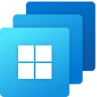
The right technology for all your needs
Windows 365
Azure Virtual Desktop
Windows 10 or Windows 11 personalized desktop
Windows 10, Windows 11, or Windows Server multi-session desktops
Predictable per user pricing
Flexible consumption-based pricing
One-stop administration in Microsoft Endpoint Manager (Enterprise edition)
Full control over configuration and management
Complete end-to-end Microsoft service, Direct self-service model (Business edition)
Remote app streaming, Citrix and VMware support

Slide 12
Guide to choosing the right cloud solution
If you want:
Windows 365
Desktop-as-a-Service
A complete facilitated Microsoft service
No VDI skills required
Personalized, persistent desktops
Business
Enterprise
No prerequisites
Fully unified
endpoint management
Remote app streaming
Multi-session/non-persistent desktops
Citrix/VMware/hybrid cloud scenarios
Choose any Azure VM (e.g. GPU) & Region
Low-usage scenarios
Azure
Virtual Desktop
Full control with a cloud VDI platform
VDI and Azure IT skills required
Windows 365
Personalized, persistent desktops
It depends on your…
Business model | IT skills/experience | IT priorities
Azure
Virtual Desktop
© 2023 NTT DATA Americas, Inc. All rights reserved.

Slide 13
Why You Should Attend the Workshop?
Workshop highlights
Focus on priorities, initiatives & key influences in your hybrid work & end-user computing strategy
Enable users to be productive, on any device, without compromising IT security
Today’s users are looking for more ways to remain productive while working on any device. 95% of organizations allow personal devices in the workspace. All these devices add additional risks, when you consider that 70 million smartphones are lost every year.
With users asking for more ways to work the way that they want, this workshop will show you how to use Cloud PC to make user productive on any device any location any platform.
Learn about end-user computing strategies, Windows 11, and Windows 365 to drive endpoint modernization
Work together on showcasing Cloud PC provisioning & management with Windows 365 in a dev environment
Plan next steps on how we can work together
Why you should attend
Experience the power of Cloud PC, AVD, Win11.
This workshop will show you how to leverage Cloud PC, AVD and Win11 to make your workforce productive from any location , any device , any platform and make corporate resources available to them securely
We’ll work with you to:
Assess your As-is Endpoint Management strategy
Discussed the prioritized scenario
Show the power of Cloud PC, Windows 11, AVD
Build a plan to your journey to work from anywhere on any device(BYOD/CYOD etc.)
© 2023 NTT DATA Americas, Inc. All rights reserved.

