Slide 1
Roadmap to Windows 11 Digital Workplace Services
April 2023

Slide 2
Flexibility is The New Normal
73%
of workers say they want flexible remote work options
67%
of employees want more in-person collaboration
80%
of managers expect more flexible work from home policies
Sources:
1. “The Work Trend Index” survey was conducted by an independent research firm, Edelman Data x Intelligence, among 31,092 full-time employed or self-employed workers across 31 markets between January 12, 2021 to January 25, 2021.
Notes:
Sustainability
OEMs use recyclable packaging where possible
Disposal/Recycling – For those assets that have reached end-of-life and are not part of a lease program that requires return to the lessor, NTT DATA can provide recycling services that includes preparation, packing materials, and shipping, where applicable, in a manner that follows EPA or equivalent local/country specific agency guidelines.
‘Green’ disposal alternatives are available for clients who elect to buy devices. Options we can provide via our partners include remarketing (net proceeds may be shared with client per pre-agreed business rules) or recycling of parts. Note that leased devices disposal will be handed by OEM at end of lease.

Slide 3
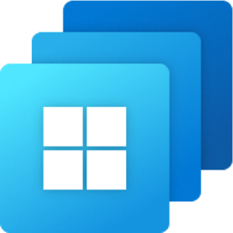
Options for Maximum Flexibility for Hybrid Workforce
Native on a PC or Tablet
VDI with Azure Virtual Desktop
Cloud PC on any device with Windows 365
across price points and form factors
optimized for flexibility and control
optimized for simplicity

Slide 4
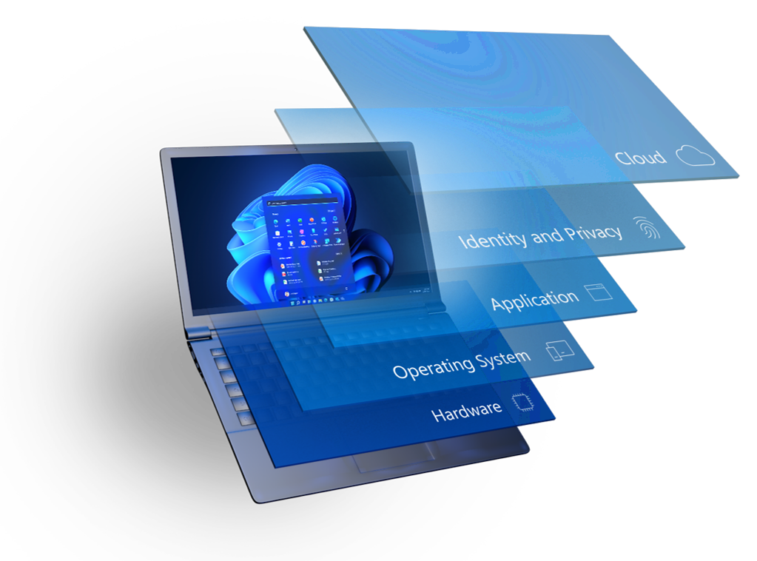
Secure by Design Windows 11
In Windows 11, hardware and software security work together to help keep people, data, and devices protected.
Protects against threats by separating hardware from software with hardware root-of-trust, for powerful security from the start
Protect the OS against unauthorized access to critical data
Delivers robust application security and prevents access to unverified code
Protects identities with passwordless security
Extends security to the cloud to help protect devices, data, apps, and identities from anywhere
Defender, OneDrive, AAD,CA, MDM
W4B, FIDO, Biometric, Access Control
UAC, App isolation, Secure Apps
BitLocker, TLS, Defender, CCSI, etc.
TPM 2.0, VBS, Secure kernel, DMA, Memory Protection

Slide 5
Roadmap to modernizing endpoints | Security
Identity and Access, Device and App Management, Zero Trust
Continue the journey with Windows 11
Identify & Access
Cloud Files and Services
Modern Devices
START
1
2
3
Cloud Identity
Password less
Conditional Access
Microsoft Defender for Identity
OneDrive
Microsoft Teams
Microsoft Defender for Office
Windows, iOS and Android
Surface / Secured Core PCs
HoloLens, Surface Hub & Specialty
Endpoint Servicing
Device Management
5
4
Windows Update for Business
M365 Apps MEC
Windows Autopilot, Co-Management
Configurations and Policies
Application Mgmt.
Device Health and Compliance
Endpoint Analytics
Virtualized Endpoints
Microsoft Managed Devices
Endpoint Security
6
7
8
Cloud managed firmware
Secure Boot and BitLocker
Windows Hello for Business
Microsoft Defender for Endpoint
Azure Virtual Desktop
Windows 365
Device management
Security monitoring
Advance the journey across the Zero Trust security model
Notes:
Sustainability
OEMs use recyclable packaging where possible
Disposal/Recycling – For those assets that have reached end-of-life and are not part of a lease program that requires return to the lessor, NTT DATA can provide recycling services that includes preparation, packing materials, and shipping, where applicable, in a manner that follows EPA or equivalent local/country specific agency guidelines.
‘Green’ disposal alternatives are available for clients who elect to buy devices. Options we can provide via our partners include remarketing (net proceeds may be shared with client per pre-agreed business rules) or recycling of parts. Note that leased devices disposal will be handed by OEM at end of lease.

Slide 6
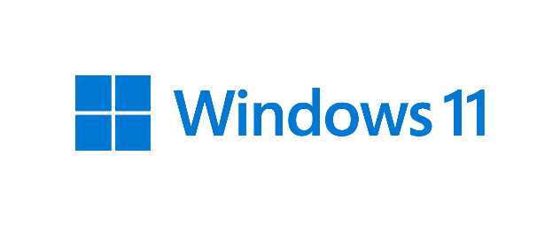
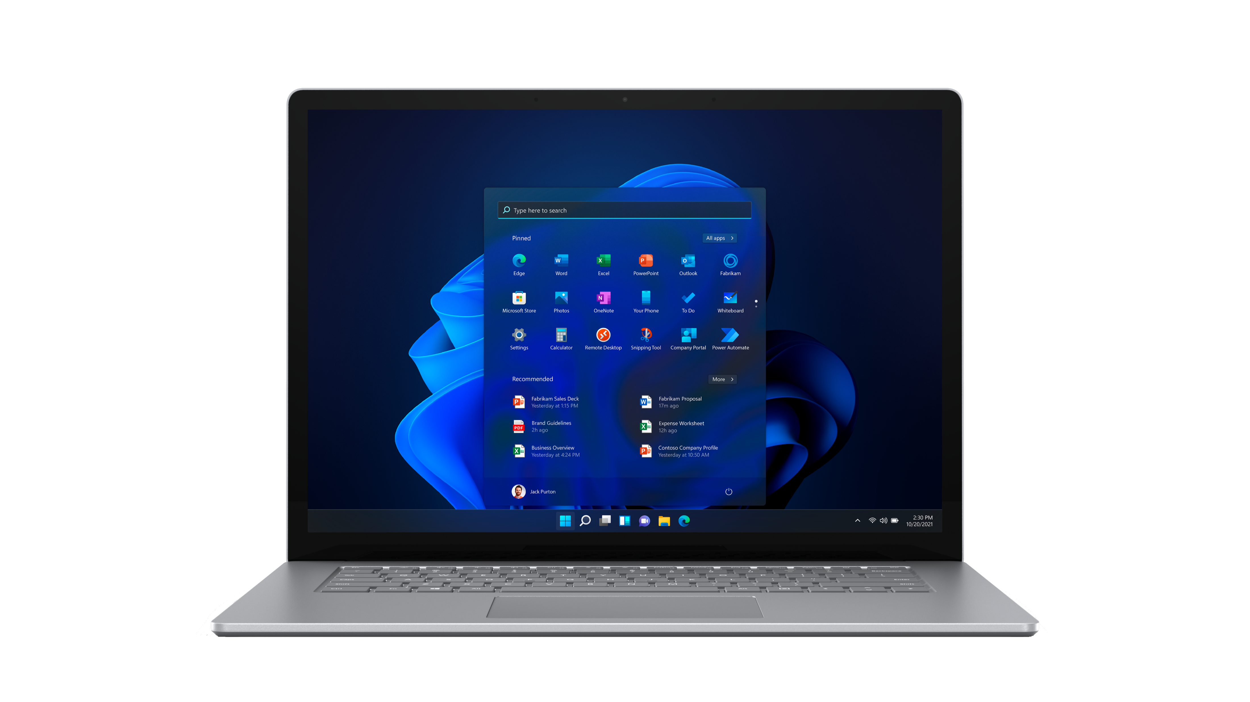
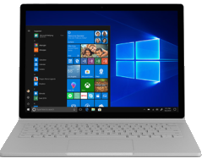
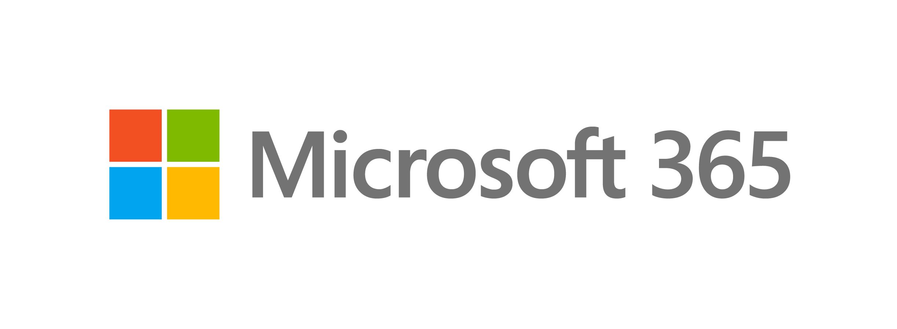
Windows 11 Deployment Approach
Consistent
Windows 10 & 11 Cohabitate:
Update devices that meet the hardware floor
Same servicing framework & process
Same tooling & management approach
Same ring strategy and approach – just another feature update
Run the same applications
Familiar user experiences
Same deployment cadence
Secure
Collaborative
Plan
Prepare
Deploy
Productive
Choice
Notes:
Sustainability
OEMs use recyclable packaging where possible
Disposal/Recycling – For those assets that have reached end-of-life and are not part of a lease program that requires return to the lessor, NTT DATA can provide recycling services that includes preparation, packing materials, and shipping, where applicable, in a manner that follows EPA or equivalent local/country specific agency guidelines.
‘Green’ disposal alternatives are available for clients who elect to buy devices. Options we can provide via our partners include remarketing (net proceeds may be shared with client per pre-agreed business rules) or recycling of parts. Note that leased devices disposal will be handed by OEM at end of lease.

Slide 7
Summary: What’s New in Windows 11
Productive
Collaborative
Secure
Consistent
Simple, modern visuals, with a new Start Menu, and enhanced user experience, including Snap groups, and Snap layouts
Great tablet experience, enables quicker actions with touch or pen, and a redesigned customizable on-screen keyboard and enhanced inking.
Integrated Voice Typing, so you can speak naturally to type
Microsoft Power Automate ships with the OS, so people can focus on what is important and automate the rest.
Inclusive video conferencing
Turn microphone on and off right from the taskbar4 so everyone’s voice is heard.
Share any windows from Taskbar4 while in a call and maintain Taskbar access while presenting.
Keep the background in the background with intelligent noise cancelling and blur.
New features that require MSA3
Teams chat from the taskbar
Widgets, personalized content
Android Apps on Windows4
New Microsoft Store
Virtualization-based security (VBS) and Hypervisor-Enforced Code Integrity (HVCI) turned on by default1
Security policies locked down and stay locked1
Improvements for Windows Hello for Business hybrid deployments and AMD USB secure camera support.
Support for Pluton security processor²
Wi-Fi 6E² support better throughput and security
Near parity between MDM and Group Policy for complete Cloud connected management.
Enhanced Universal Print saves cost by eliminating print servers
Run virtual apps like local, Windows 11 works better together with virtual desktop, and virtualized apps
One feature release per year and 36 months of servicing per release
Windows 365 Enterprise entitlement
Notes:
Various views to talk through depending on the audience
CHRO – Point, and so on..

Slide 8
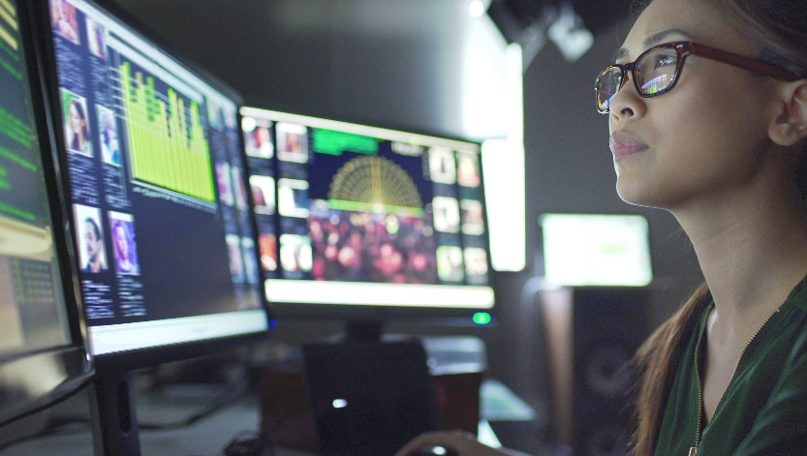
Why NTT DATA for Digital Workplace Services
Gartner® 2023 Magic Quadrant for Outsourced Digital Workplace Services, Worldwide
Everest Group’s Digital Workplace Services PEAK Matrix® Assessment, 2022
Gartner® 2022 Magic Quadrant for Network Services, Global
NelsonHall NEAT for Advanced Digital Workplace Services, 2021
#1
Recognized as a Leader
Microsoft Operator Connect Partner &
Top Performer for Teams Telephony
65%
Contacts resolved with automation & bots
Global Cisco partner delivering first-class service for more than 10 years
1M+
Cloud Voice & Managed Services users with MS Teams & Cisco
65%
Tier 1
Top-tier global cloud communications provider
One of the largest service desk support user base
3.8M+
30M+
10B+
23M+
6.2M+
2.5K+
Users supported
Meetings hosted
Minutes of cloud voice
29 ISO-Certified Delivery Locations
Annual service desk contacts
Managed
users
Service desk agents
© 2023 NTT DATA Americas, Inc. All rights reserved.
Notes:
We are now a $30B powerhouse with expertise and experience to serving our clients at scale.
OEMs partner of choice
A recognized global leaders in Digital Workplace Services by all major Analysts like Gartner, Everest and NelsonHall.
Over 1M users for Cloud Voice & Managed Services with MS Teams and Cisco
Agents for Contact Centers….
Microsoft OC Partner

