Slide 1
Next Gen Windows Advisory Workshop
Digital Workplace Services
April 2023

Slide 2


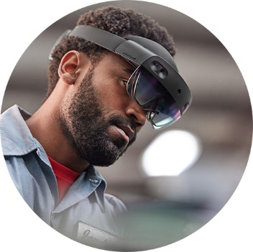
Hybrid Work Is Transforming Endpoint Management Strategy
90%
of surveyed companies claimed a multicloud strategy is working for their enterprises.¹
90%
of clients will use cloud-based Unified Endpoint Management tools to manage most of their estate, by 2025.²
70%
of connected workers in task-based roles will use intelligence embedded in adaptive digital workspaces by 2023.³
Sources:
HashiCorp State of Cloud Strategy Survey 2022, commissioned by Forrester Consulting
Gartner Magic Quadrant for Unified Endpoint Management Tools, 2022.
3. IDC FutureScape: Worldwide Future of Work 2022 Predictions

Slide 3
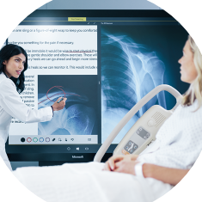



Endpoint Management Strategy Driving User Segmentation
Security
and regulation
Elastic
workforce
Remote
employees
Specialized
workloads
Financial services
Healthcare
Government
Mergers and acquisition
Short-term employees
Contractors and partners
BYOD and mobile
Call centers
Branch workers
Design and engineering
Legacy apps
Software dev test
Meet these demands with a Virtual Workspace

Slide 4


Employees and Business Expectations Are Evolving
Employees expect
Businesses expect
Personal
and familiar
Streamed to any devices
Always ready and updated
Scalable ​
and resilient
Optimized costs
Compliance & security, ease of management
Meet these demands with a Next-Gen-Windows Platform

Slide 5

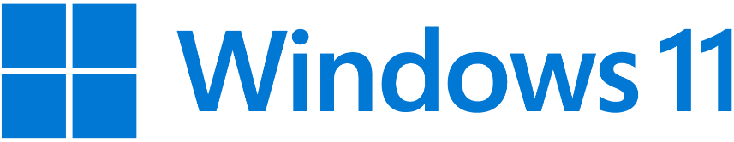
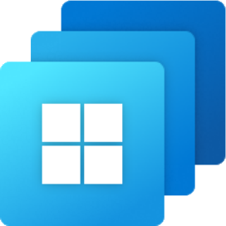


Options for Maximum Flexibility for Hybrid Workforce
Native on a PC or Tablet
VDI with
Azure Virtual Desktop
Cloud PC on any device with Windows 365
across price points and form factors
optimized for flexibility and control
optimized for simplicity

Slide 6
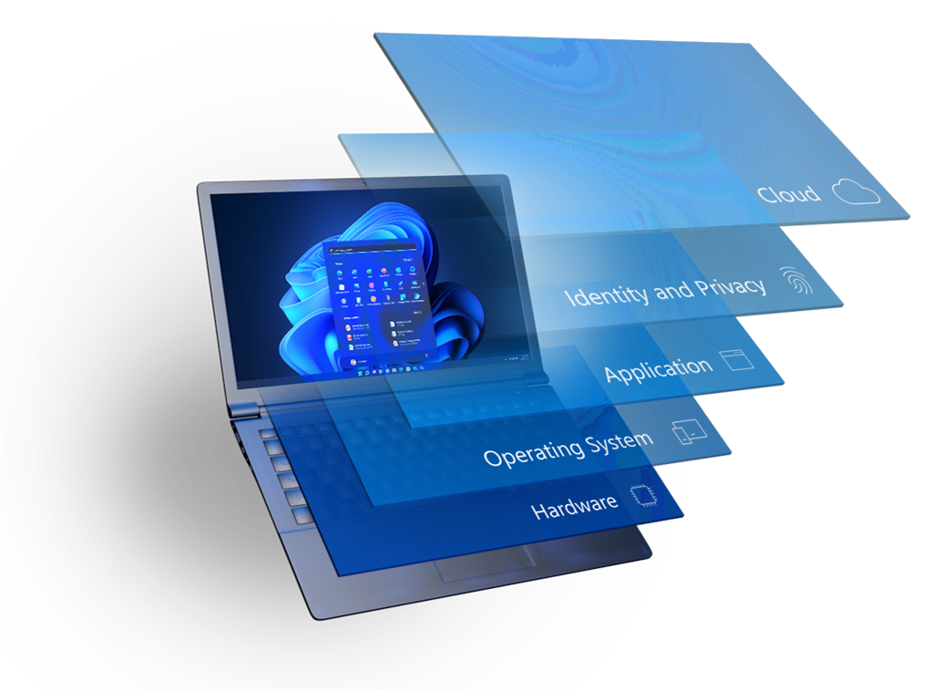
Secure by Design Windows 11
In Windows 11, hardware and software security work together to help keep people, data, and devices protected.
Protects against threats by separating hardware from software with hardware root-of-trust, for powerful security from the start
Protect the OS against unauthorized access to critical data
Delivers robust application security and prevents access to unverified code
Protects identities with passwordless security
Extends security to the cloud to help protect devices, data, apps, and identities from anywhere
Defender, OneDrive, AAD,CA, MDM
W4B, FIDO, Biometric, Access Control
UAC, App isolation, Secure Apps
BitLocker, TLS, Defender, CCSI, etc.
TPM 2.0, VBS, Secure kernel, DMA, Memory Protection

Slide 7
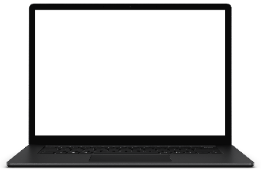


Virtual Workspace Options by Microsoft | Windows 365 & Azure Virtual Desktop
Deliver personal computing from
cloud to client through Software as a Service (SaaS)
Migrate and modernize virtual desktops and apps through Infrastructure as a Service (IaaS)
Windows 365|
Cloud PC
Azure Virtual Desktop
PCs/Mobile
On-prem VDI

Slide 8
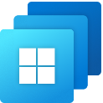
Comparison | Windows 365 Vs Azure Virtual Desktop
Windows 365
Azure Virtual Desktop
A complete SaaS service that securely streams your personalized Windows desktop, apps, settings, and content from Microsoft Cloud to any device.
A cloud VDI platform that delivers hosted desktops and apps on Cloud infrastructure with maximum flexibility and control.
 | Windows 365 - Cloud PC | Azure Virtual Desktop - Cloud VDI
OS Support | Windows 11 or Windows 10 | Windows 11, Windows 10, single or multi-session, Windows Server
Admin | Microsoft Endpoint Manager (Enterprise) Web self-service (Business) | Azure Portal VMware or Citrix management panel
Service | SaaS: complete end-to-end Microsoft service | PaaS: granular controls over configuration and management
Pricing | Per-user, per month | Consumption-based
Scale | Unlimited based on subscription | Unlimited based on consumption
End-user | Full Windows like-local experience | Single or multi-user, pooled, remote app

Slide 9
Key Considerations to Select the Right Solution
Windows 365
Azure Virtual Desktop
Simplified management with SaaS model
Shared responsibility with IaaS model
Subscription based model, predictable cost
Consumption-based model, based on demand
Persistent Desktop experience only
Persistent/ Non-persistent, multisession, pool deployment, Remote App publication
No or little virtualization skill is required
Virtualization is in house skill

Slide 10



Virtual Workspace Services by NTT DATA
Advisory Services
Build Services
Managed Services
  Virtualization strategy
  Define your endpoint virtualization strategy
  Architect, design and deploy
  Define and implement the virtual workspace solution including Windows 365 & AVD
  Infrastructure management
  Manage the cloud component of Windows 365, Azure Active Directory, on-premise network connection, Provisioning policies, persona-based deployment etc.
  Persona identification
  Advise and help customer in persona identification and map compute needs with persona
  Persona based provisioning
  Automate the persona-based deployment of virtual workspace including Windows 365 & AVD
  VM’s lifecycle management
  License assignment, provisioning, de-provisioning, application deployment, monitoring etc.
  Design virtual workspace
  Design virtual workspace solution based on the persona
  Automated application deployment
  Design and define process for application deployment on virtual workspace including Windows365 & AVD
  Image management
  Manage the lifecycle of golden image for VMs
  Design framework for continues innovation
  Design and define process for virtual workspace for continues innovation and optimization
  Lifecycle management
  Design and deploy the life cycle of virtual workspace including Windows 365 & AVD
  Manage application lifecycle & endpoint estate
  Deploy and manage application life cycle of Windows 365 & AVD
  Manage endpoint estate including Windows 365 & AVD

Slide 11


Why NTT DATA for Digital Workplace Services
Gartner® 2023 Magic Quadrant for Outsourced Digital Workplace Services, Worldwide
Everest Group’s Digital Workplace Services PEAK Matrix® Assessment, 2022
Gartner® 2022 Magic Quadrant for Network Services, Global
NelsonHall NEAT for Advanced Digital Workplace Services, 2021
#1
Recognized as a Leader
Microsoft Operator Connect Partner &
Top Performer for Teams Telephony
65%
Contacts resolved with automation & bots
Global Cisco partner delivering first-class service for more than 10 years
1M+
Cloud Voice & Managed Services users with MS Teams & Cisco
65%
Tier 1
Top-tier global cloud communications provider
One of the largest service desk support user base
3.8M+
30M+
10B+
23M+
6.2M+
2.5K+
Users supported
Meetings hosted
Minutes of cloud voice
29 ISO-Certified Delivery Locations
Annual service desk contacts
Managed
users
Service desk agents
© 2023 NTT DATA Americas, Inc. All rights reserved.
Notes:
We are now a $30B powerhouse with expertise and experience to serving our clients at scale.
OEMs partner of choice
A recognized global leaders in Digital Workplace Services by all major Analysts like Gartner, Everest and NelsonHall.
Over 1M users for Cloud Voice & Managed Services with MS Teams and Cisco
Agents for Contact Centers….
Microsoft OC Partner

