Slide 1
Modern Device Management
Digital Workplace Services
January 2023

Slide 2




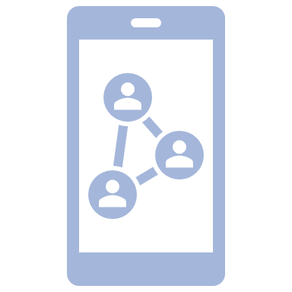








The Endpoint Management Challenges Have Evolved Over Time
Distributed Workers
Endpoint Diversity
Employee Satisfaction
Cybersecurity
Config
Mgmt.
Reporting
Encryption
Software
Company-
Owned
Devices
Corp Users
Cloud Apps
Mobile
Devices
Software
Updates
Security
Software
Policies
Legacy
Devices
Remote
Users
User
Access
& Mgmt.
Client Apps
Device
Mgmt.
Analytics
Firewall
User-
Owned
Devices
Guest
Users
Mobile
Apps
Remote & hybrid
work environments
Multiple devices &
app platforms
Easy, fast access to company resources
Mitigating risk & vulnerabilities
Notes:
This evolution makes this more complex.. Hybrid work bring new challenges / new opportunity / enterprise who embrace technology will thrive in this paradigm shift / enterprise who still operate on legacy tech / legacy ways will be behind the curve..
You need modern management to navigate this complexity → what is modern management -- ? Next slide describe that..

Slide 3






Need For Modern Device Management
Flexible Cloud based solution
Simplify IT administration & operations
Elevate employee experience
Protection built on Zero Trust security principles
Quickly resolve issues with automation & data-driven insights
Modern Device Management
Enable unified collaboration
Consistently manage existing &
new devices
3
Notes:
Solution of the challenges is Modern Management – in this slide we defined what is modern management, and in next slide we talked about Solution which provide Modern management.

Slide 4


Enable Any Device, Anywhere with NTT DATA
Unified
Endpoints
Optimized Cost
& Resources
Content
Management
Information
Management
AI-Powered
Analytics
Provisioning Integrated Security
Identity
Modernization
Automation On Cloud Monitoring
NTT DATA
Modern
Device
Management
Application
Management
Mobility
Management
Data
Prevention
User
Privacy
(BYOD) Bring
Your Own Device
Digital
Experience
Compliance
© 2023 NTT DATA Americas, Inc. All rights reserved.

Slide 5









Our Experience-Centric Approach to Modern Device Management
Endpoint Lifecycle Management
Refresh
Complete visibility into endpoints
Automation enabled operations
Over-the-air configuration for instant delivery of policies, apps & updates
Profile-based policy & content management & distribution
Ubiquitous IT access with self-service onboarding & IT services consumption
Enhanced productivity
Compliance automation & data protection
Change
Troubleshoot
Employee Experience
Procurement
Deployment
Business ready
Management
Retirement
EX/ UX Monitoring & Analytics
Notes:
Refer old deck again and then we can discuss

Slide 6

Powered by Artificial Intelligence
Automated Persona-Based App Distribution
Device application, content & access management,
persona-based distribution management
Autonomous System
Desired configuration management, self-heal & configuration drift control
Experience Monitoring
UX/EX monitoring like application crashes, hardware crashes, login issues & network issues
Modern device monitoring for all devices & form factors
Proactive Monitoring
Endpoint monitoring, device health management,
event, incident & configuration
management
Digital Employee Experience Score
Total experience calculated by AI-driven analytics engine
Notes:
Sandeep to provide input on monitoring and then sync with the team
Title – Endpoint monitoring and automation powered by AI

Slide 7





Delivering Business Outcomes
Enhanced end-user experience
Improve flexibility & productivity
by allowing employees to use their smartphones to access corporate applications.
Improved
security
Reduce the burden of managing multiple tools so security teams can improve security posture & lower the threat of security incidents.
Redeployed
IT time
Enable faster & smoother remote device provisioning & upgrades so that IT teams can spend less time monitoring & facilitating planned updates & reconfigurations.
Reduced support needs
Significantly reduce the total ticket queue for IT teams & enable them to manage endpoints remotely to continually lower the number of
support requests.
Better sustainability
Move to the cloud & retire former solutions to save licensing fee costs as well as hardware & maintenance costs.

Slide 8
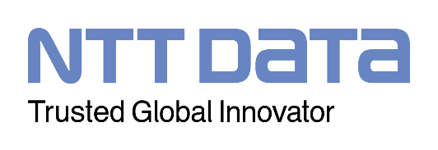

Service overview at-a-glance
An end-to-end approach to modernized workplace IT support & transformation that leverages best-in class integrated lifecycle management platforms for multiple desktop & mobile operating systems. Clients benefit from our proven identity & access management, enhanced security, privacy assurance & actionable analytics at every stage of the device lifecycle.
Modern Device Management
Securely manage your diverse device ecosystem
BASE FEATURES
OPTIONAL FEATURES
BENEFITS
WHY NTT DATA?
Device/ Endpoint Management
Modern device management using cloud-based solutions such as Microsoft Intune and/or VMware Workspace One
Patch management, endpoint monitoring, health management, event & incident management, problem hunting
Operating System Lifecycle Management
Zero touch device provisioning
Provisioning packages design & lifecycle management
Enterprise Applications Lifecycle Management
Commercial off-the-shelf software (COTS) & client enterprise software deployment & version lifecycle management
Device/Endpoint compliance, encryption & security management
Endpoint security policy continuous baselining, management & monitoring
User Experience Monitoring, Advanced Workplace Analytics & UX Index Lifecycle Management
Enabled through agent-based, end-user experience monitoring platforms to derive advanced analytics & improve UX lifecycle management
Endpoint Automation/Custom Endpoint Automation Lifecycle Management
Reactive self-heal, configuration drift control or automated guaranteed state
Enhanced Endpoint Security Management
Full lifecycle management support for third-party endpoint antimalware, host IDS, DLP & encryption software, including SOC integration & emergency/critical response support
2M+ end users & 6.5M+ end user devices supported
Improve the reliability & predictability of workplace IT to support critical business initiatives
Continual service improvement methodology to increase workplace productivity & enhance security posture
Global reach with a well-established network of trusted partners
Extensive experience delivering to regional & industry-specific requirements
Continuously monitor & address performance & user experience against service level agreements & KPIs
Gain immediate visibility & control over the entire fleet of devices connected into the corporate network
Strong partnerships with Microsoft & VMware
A Leader in Gartner® 2023 Magic Quadrant for Outsourced Digital Workplace Services, Worldwide¹
© 2023 NTT DATA Americas, Inc. All rights reserved.
8
¹ Gartner® 2023 Magic Quadrant for Outsourced Digital Workplace Services, Worldwide, March 2023

